Slide 1

What are some Knowledge Graph Inference Algorithms?

Slide 2
Introduction
Knowledge Graph Retrieval
Query languages
SPARQL and Cypher
Knowledge Graph Inference
Drawing conclusions that are not explicit in the knowledge graph
E.g., shortest path, concluding new connections

Slide 3
Outline
Knowledge Graph Inference
Graph-based inference algorithms
Ontology-based inference algorithms

Slide 4
Graph-based Inference Algorithms
Path finding
Centrality Detection
Community Detection

Slide 5
Path Finding
B
8
6
A
5
C
1
3
2
D
E
4

Slide 6
Path Finding
Shortest path
Optimal path in traffic planning
B
8
6
A
5
C
1
3
2
D
E
4

Slide 7
Path Finding
Single Source Shortest path
B
8
6
A
5
C
1
3
2
D
E
4

Slide 8
Path Finding
Minimum Spanning Tree
Trip planning
B
8
6
A
5
C
1
3
2
D
E
4

Slide 9
Path Finding
A* Algorithm
Maintain a tree of paths from the start node
Extend them until termination criteria is met
Extend based on estimated length
f(n)=g(n)+h(n)
f(n) = cost until now
g(n) – current cost
h(n) – estimated cost
B
8
6
A
5
C
1
3
2
D
E
4

Slide 10
Path Finding
A* Algorithm
Well-known path finding algorithm
Originally developed for AI planning
B
8
6
A
5
C
1
3
2
D
E
4

Slide 11
Path Finding
A* Algorithm
Maintain a tree of paths from the start node
Extend them until termination criteria is met
Extend based on estimated length
f(n)=g(n)+h(n)
f(n) = cost until now
g(n) – current cost
h(n) – estimated cost
B
8
6
A
5
C
1
3
2
Admissible heuristic
- Never over estimate
D
E
4

Slide 12
Path Finding
A* Algorithm
Shortest path from A to E
h(n)=0
Breadth first search
Dijkastra’s algorithm
8
B
A, B 8
A, C 5
A, D 1
8
6
A
5
C
5
1
3
2
1
D
E
4

Slide 13
Path Finding
A* Algorithm
Shortest path from A to E
h(n)=0
Breadth first search
Dijkastra’s algorithm
8
B
A, B 8
A, C 5
A,D 1
A, D, C 4
A, D, E 5
8
6
A
5
C
5
4
1
3
2
1
D
E
5
4

Slide 14
Path Finding
A* Algorithm
Shortest path from A to E
h(n)=0
Breadth first search
Dijkastra’s algorithm
8
B
A, B 8
A, C 5
A,D 1
A, D, C 4
A, D, C, E 6
A, D, E 5
8
6
A
5
C
5
4
1
3
2
1
D
E
5
4

Slide 15
Graph-based Inference Algorithms
Path finding
Centrality Detection
Community Detection

Slide 16
Centrality Detection
Helps in understanding the importance of a node in a network
Most important nodes
Bridges in a network

Slide 17
Centrality Detection
Helps in understanding the importance of a node in a network
Degree Centrality
A has the highest degree
A
B

Slide 18
Centrality Detection
Helps in understanding the importance of a node in a network
Degree Centrality
A has the highest degree
A
B
Betweenness Centrality
B has the largest number of shortest paths passing through it

Slide 19
Centrality Detection
Helps in understanding the importance of a node in a network
C
Degree Centrality
A has the highest degree
A
Closeness Centrality
C is closest to all the nodes in this network
B
Betweenness Centrality
B has the largest number of shortest paths passing through it

Slide 20
Centrality Detection
Helps in understanding the importance of a node in a network
C
Degree Centrality
A has the highest degree
A
Closeness Centrality
C is closest to all the nodes in this network
B
Betweenness Centrality
B has the largest number of shortest paths passing through it
D
Page Rank
D has the highest number of weighted edges coming into it

Slide 21
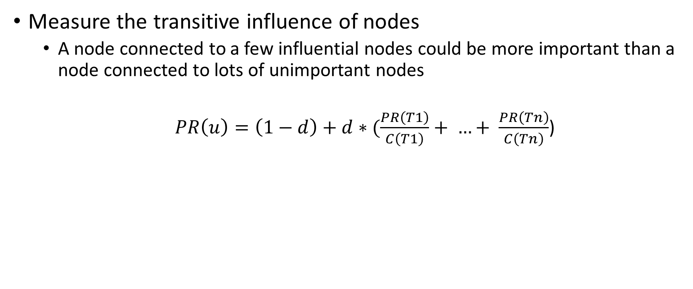
Page Rank
Measure the transitive influence of nodes
A node connected to a few influential nodes could be more important than a node connected to lots of unimportant nodes
$PR\left(u\right)=\left(1−d\right)+d∗(\frac{PR\left(T1\right)}{C\left(T1\right)}+ …+ \frac{PR\left(Tn\right)}{C\left(Tn\right)}$)
d – damping factor is usually set to 0.85
Set the values of PR for all nodes to same value, and iteratively improve it

Slide 22
Graph-based Inference Algorithms
Path finding
Centrality Detection
Community Detection

Slide 23
Community Detection
Identify nodes in the graph that are closely connected to each other
More relationships between nodes within the community
Could be the first step in understanding a graph
More in-depth analysis of nodes within the community

Slide 24
Community Detection
Two families of algorithms
Standard graph algorithms
Bottom up algorithms

Slide 25
Community Detection Algorithms
Standard Graph Algorithms
A
F
G
B
C
D
E

Slide 26
Community Detection Algorithms
Standard Graph Algorithms – Connected components
A
F
G
B
C
D
E

Slide 27
Community Detection Algorithms
Standard Graph Algorithms – Strongly connected components
A
F
G
B
C
D
E

Slide 28
Community Detection Algorithms
Bottom up algorithms
Label propagation
Unfolding

Slide 29
Community Detection Algorithms
Label Propagation
Assign each node to be in a different community
Examine all nodes in a fixed order
Update the community of a node that is shared by most of its neighbors
Break Ties in a random order
Terminate when each node is in a community shared by most of its neighbors

Slide 30
Community Detection Algorithms
Unfolding (Also known as Louvain)
Phase I
Assign each node into a separate community
Examine each node and its neighbors to test if there will be an overall gain in modularity by placing it in the same community as a neighbor
Modularity calculated by a formula
Phase II
Create a new graph in which each node represents a community from Phase I
If there are edges between nodes in a community, represent it as a self-loop
Repeat Phase I on the Phase II graph

Slide 31
Outline
Knowledge Graph Inference
Graph-based inference algorithms
Ontology-based inference algorithms

Slide 32
Ontology-based Inference
Key differentiator between a general graph and a knowledge graph
Associates classes with nodes
Defines semantic properties of relationships
Two major categories of inference
Class-based Inference or Taxonomic Reasoning
Rule-based inference

Slide 33
Taxonomic Reasoning
Applicable when it is useful to organize knowledge into classes
Classes are nothing but unary relations or types
Membership, specialization, disjointness, value restriction
Both Property graph and RDF data models support classes
In property graphs model, node type is the same as a class
RDF has an RDF schema layer
More advanced systems use a full-fledged ontology language OWL
Our discussion here will be independent of either of the two models

Slide 34
Example of classes
male(art) |  | female(bea)
male(bob) |  | female(coe)
male(cal) |  | female(cory)
male(cam)
class(male) instance_of(art,male) |  | class(female) instance_of(bea,female)
instance_of(bob,male) |  | instance_of(coe,female)
instance_of(cal,male) |  | instance_of(cory,female)
instance_of(cam,male)

Slide 35
Class specialization
We can organize classes into a hierarchy
e. g., male and female are subclasses of person
subclass-of(female, person)
subclass-of(male, person)
subclass relationship is transitive
subclass_of(A,C) :- subclass_of(A,B) & subclass_of(B,C)
subclass and instance-of relationships are related
instance_of(I,B) :- subclass_of(A,B) & instance_of(I,A)

Slide 36
Disjoint classes
Classes can be declared to be disjoint
e.g, disjoint(male,female)
i.e., they do not have any instances in common
illegal :- disjoint(A,B) & instance_of(I,A) & instance_of(I,B)
or
illegal(“Disjoint classes cannot have an instance in common”) :-
disjoint(A,B) & instance_of(I,A) & instance_of(I,B)

Slide 37
Class Definition
Necessary properties of a class
Will have instance-of in the body of the rule
has_hair_color(X,brown) :-
instance_of(X,brown_haired_person)
Sufficient properties of a class
Will have instance-of in the head of the rule
instance_of(X,brown_haired_person) :-
instance_of(X,person) &
has_hair_color(X,brown)

Slide 38
Value Restriction
We can restrict the arguments of a relation to be instances of a specific class
domain is the restriction on the first argument
illegal :- domain(parent,person) &
parent(X,Y) &
~instance_of(X,person)
range is the restriction on the second argument
illegal :- range(parent,person) &
parent(X,Y) &
~instance_of(Y,person)

Slide 39
Cardinality and Number Restrictions
We can further restrict the values of relations by specifying cardinality and number restrictions
A cardinality restriction limits the number of values of a relation
illegal :- instance_of(X,person) & ~countofall(P,parent(P,X),2)
A numeric range restriction limits the minimum and maximum value
illegal :- instance_of(X,person) & age(X,Y) & min(0,Y,Y)
illegal :- instance_of(X,person) & age(X,Y)& min(125,Y,100)

Slide 40
Inheritance
The relation values are said to inherit to the instances of a class
If art is an instance of the class brown-haired-person, we can conclude that art has brown hair

Slide 41
Taxonomic Inference
Given two classes A and B, whether A is a subclass of B?
Given a class A and an instance I, whether I is an instance of I?
Given a ground relation atom determine whether it is true or false?
Given a relation atom, determine values which values make it true?

Slide 42
Rule-based Inference
Boundary between taxonomic inference and rule-based inference is not sharp
It is generally a matter of the implementation approach
Taxonomic inferences can be usually implemented using rules

Slide 43
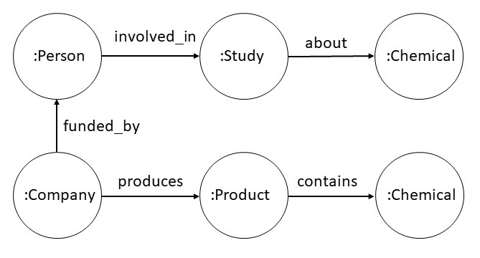
Rule-based inference
Example Scenario

Slide 44
Rule-based inference
Example Scenario
has_interest(X,Z) :- produces(X,Y) & contains(Y,Z)
coi(X,Y,Z) :-
involved_in(X,Y) & about(Y,P) &
funded_by(X,Z) & has_interest(Z,P)

Slide 45
Rule-based inference
Example Scenario
has_interest(X,Z) :- produces(X,Y) & contains(Y,Z)
coi(X,Y,Z) :-
involved_in(X,Y) & about(Y,P) &
funded_by(X,Z) & has_interest(Z,P)
∃c conflict_of(c,X) & conflict_reason(c,Y) &
conflict_with(c,Z) :-
involved_in(X,Y) & about(Y,P) &
funded_by(X,Z) & has_interest(Z,P)

Slide 46
Rule-based Inference
Approaches
Bottom up strategy (also known as Chase)
Apply the rules against the data, and add new facts
Ensure termination
Process queries as usual
Top-down strategy
Start from the query, and apply rules as needed
Requires tighter integration between the rule engine and query evaluation
Requires lot less space
Many efficient and scalable rule engines available today

Slide 47
Summary
Graph inference algorithms fall into two broad categories
Traditional Graph Algorithms
Path finding, centrality, community detection
Ontology-based algorithms
Taxonomic reasoning, Rule-based reasoning

